Slide 1
Input Devices in Computer Graphics

Slide 2
An Input device is the piece of computer hardware equipment used to give input to the computer. The input can be in the form of graphics, text, sound, audio, video, and image, etc. “Input devices are those devices through which we can give the data and instructions to the computer.”
For Example– Mouse, Trackball, Keyboard, Light pen, etc.
Classification of Input Devices
Manual data entry devices
Direct data entry devices

Slide 3
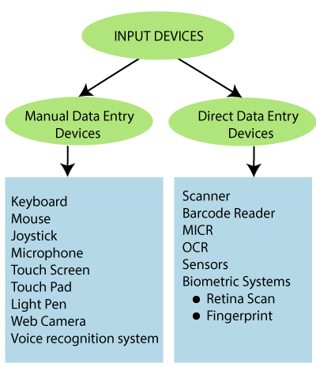

Slide 4
Output Devices in Computer Graphics
An output device is a component of hardware or the main physical part of a computer that can be touched and seen. An output device is an electromechanical device.
“The Computer gives instructions and data from input devices and processes it and returns the result called as output.”
For Example: Printer, Plotter, Monitor, Projector etc.

Slide 5
Display Devices in Computer Graphics
The display device is an output device used to represent the information in the form of images (visual form). Display systems are mostly called a video monitor or Video display unit (VDU).
Display devices are designed to model, display, view, or display information. The purpose of display technology is to simplify information sharing.
Today, the demand for high-quality displays is increasing.
There are some display devices given below:
Cathode-Ray Tube(CRT)
Color CRT Monitor
Liquid crystal display(LCD)
Light Emitting Diode(LED)
Direct View Storage Tubes(DVST)
Plasma Display
3D Display

Slide 6
Image Representation in Computer Graphics
Image Representation: In computer science, we can represent an image in various forms. Most of the time, it refers to the way that brings information, such as how color is coded digitally, and how the image is stored, i.e., how an image file is structured.
Several open standards were recommended to create, manipulate, store, and exchange digital images. The rules described the format of image files, the algorithms of image encoding, the form of additional information often named as metadata.
A digital image is the composition of individual pixels or picture elements. The pixels are arranged in the form of row and column to form a picture area. The number of pixels in an image is a function of the size of the image and number of pixels per unit length (e.g., inch) in horizontal as well as vertical direction.

Slide 7
Image Processing
It is a method to implement some operations on an image. It is also used to get an enhanced image or to access some useful information from an image. It is a type of processing in which the input is an image, and output may be the image or characteristics/features correlated with that image.
For example– photographs, frames of video.
Most image processing techniques consider the image as a two-dimensional and applying standard signal-processing technique on it.
Pixel: “Pixel is the smallest unit of a picture displayed on the computer screen.”
A pixel includes its own:-
Intensity
Name or Address
The size of the image is defined as the total number of pixels in the horizontal direction times the total number of pixels in the vertical direction (512 x 512,640 x 480, or 1024 x 768).
The ratio of an image’s width to its height, we can measure it in unit length or number of pixels, is known as the aspect ratio of the image.
For example– A 2 x 2inch image and a 512 x 512 image have an aspect ratio of 1/1, whereas a 6 x 4inch image and a 1024 x 768 image have an aspect ratio of 4/3.

Slide 8
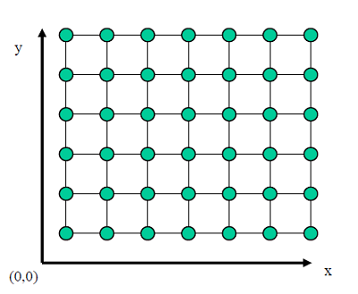

Slide 9
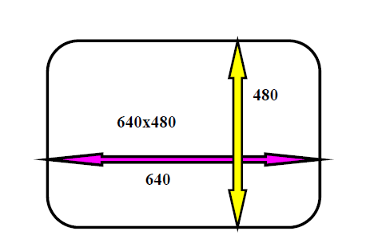
Resolution: It is the number of separate pixels display on a screen expressed in terms of pixels on the horizontal axis and vertical axis.
The sharpness of the picture on display depends on the resolution and the size of the monitor.
“The number of pixels per unit is called the resolution of the image.”
It also includes-
Image Resolution: “The distance between two pixels.”
Screen Resolution: “The number of horizontal and vertical pixels displayed on the screen is called Screen Resolution.”
For Example– 640 x 480, 1024 x 768 (Horizontal x Vertical)

Slide 10
Aspect Ratio: “The ratio of image’s width to its height is known as the aspect ratio of an image.” The height and width of an image are measured in length or number of pixels.
For Example: If a graphics has an aspect ratio of 2:1, it means the width is twice large to height.
It includes–
Frame aspect ratio: Horizontal /Vertical Size
Pixel aspect ratio: Width of Pixel/Height of Pixel
Applications of Image Processing
Some application areas of Image Processing are as follow:
Computerized Photography
Space Image Processing (e.g., Hubble space telescope image, Interplanetary probe images)
Medical/ Biological Image Processing
Automatic Character Recognition
Fingerprint/ Face/ Iris Recognition
Remote sensing
Industrial application

Slide 11
Color Models in Computer Graphics
“Color model is a 3D color coordinate system to produce all range of color through the primary color set.” There are millions of colors used in computer graphics. The light displays the color. A Color model is a hierarchical system in which we can create every color by using RGB (Red, Green, Blue) and CMYK (Cyan, Magenta, Yellow, Black) models. We can use different colors for various purposes.
The total number of colors displayed by the monitor depends on the storage capacity of the video controller card.
The Video controller card is used as an interface between the computer system and the display device. It is also known as “Video Random Access Memory (VRAM).”

Slide 12
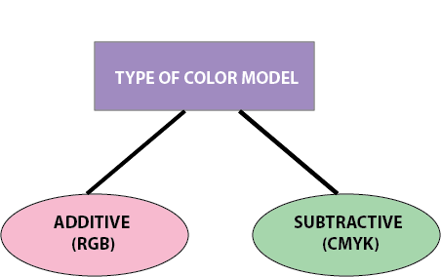
Types of Color Model

Slide 13
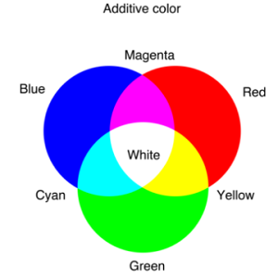
Additive color Additive Color Model: It is also named as “RGB model.” RGB stands for Red, Green, Blue. The Additive color model uses a mixture of light to display colors. The perceived color depends on the transmission of light. It is used in digital media. For Example– Computer Monitor, Television etc.

Slide 14
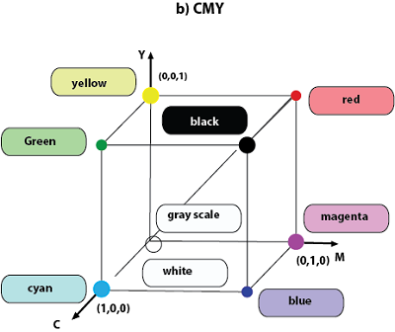
Subtractive Color Model: It is also named as “CMYK Model.” CMYK stands for Cyan, Magenta, Yellow, and Black. The Subtractive model uses a reflection of light to display the colors. The perceived color depends on the reflection of light. The CMYK model uses printing inks. For Example– Paint, Pigments, and color filter etc.

Slide 15
Color Look-Up Table
The color Look Up table is a technique or process to convert a range of input colors into another range of colors. It is also called as “CLUT.” The color Lookup table has existed in the graphics card. Graphics Card is also called “Display Adapter.” The Color Look-Up table provides us various colors that are used to modify the color of the objects. Either we can use the colors available in the palette, or we can create the colors of our choice in the color window.
In image processing, the lookup table is used to change the input into the more required output format. The Color Look-Up table is used to store and index the color value of an image.

Slide 16
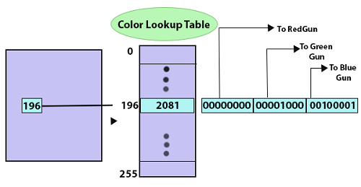
Look Up File: The Look-Up file is a two-dimensional table that is used to contain the data. The Look Up data is stored in a disk file.
Color Palettes: The color palettes are defined as mathematical tables used to determine the color of the pixel that is displayed on the screen.
In the Macintosh Operating system, it is known as “Color Look-Up table.”
In Windows operating system, it is known as the “Color palette.”
It is used to stores a set of bytes instead of the color of the image.

Slide 17
Direct Coding
“Direct Coding is a technique or process which is used to provide a certain amount of memory storage space for a pixel to encode the pixel with the color.”
For Example– If we assign one bit for each primary color to 3-bit for each pixel. This 3-bit representation allows the two intensity levels of each primary to separate: 0(Off) or 1(On),then each pixel can occupy one color out of eight colors that are similar to the corner of the RGB color cube.

Slide 18
Bit1: Red | Bit2: Green | Bit: Blue | Color Name
0 | 0 | 0 | Black
0 | 0 | 1 | Blue
0 | 1 | 0 | Green
0 | 1 | 1 | Cyan
1 | 0 | 0 | Red
1 | 0 | 1 | Magenta
1 | 1 | 0 | Yellow
1 | 1 | 1 | White

